Slide 1

4.2 Probability Distributions and Probability Density Functions
1. The probability density function of the length of a cutting blade is millimeters. Determine the following:
(c) If the specifications for this process are from 74.7 to 75.3 millimeters, what proportion of blades meets specifications?

Slide 2
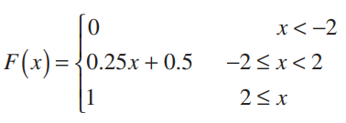

4.3 Cumulative Distribution Functions
2. Suppose that the cumulative distribution function of the random variable X is
Determine the following:

Slide 3


4.4 Mean and Variance of a Continuous Random Variable
3. Suppose that for . Determine the mean and variance of X .

Slide 4


4.4 Mean and Variance of a Continuous Random Variable
4. The thickness of a conductive coating in micrometers has a density function of for .
(a) Determine the mean and variance of the coating thickness.
(b) If the coating costs $0.50 per micrometer of thickness on each part, what is the average cost of the coating per part?

Slide 5
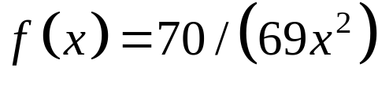

4.4 Mean and Variance of a Continuous Random Variable
5. The probability density function of the weight of packages delivered by a post office is for pounds.
(a) Determine the mean and variance of weight.
(b) If the shipping cost is $2.50 per pound, what is the average
shipping cost of a package?
(c) Determine the probability that the weight of a package exceeds 50 pounds.

Slide 6
4.5 Continuous Uniform Random Variable
6. The thickness of a flange on an aircraft component is uniformly distributed between 0.95 and 1.05 millimeters.
Determine the following:
(a) Cumulative distribution function of flange thickness.
(b) Proportion of flanges that exceeds 1.02 millimeters.
(c) Thickness exceeded by 90% of the flanges.
(d) Mean and variance of flange thickness.

Slide 7
4.5 Continuous Uniform Random Variable
6. The thickness of a flange on an aircraft component is uniformly distributed between 0.95 and 1.05 millimeters.
Determine the following:
(a) Cumulative distribution function of flange thickness.
(b) Proportion of flanges that exceeds 1.02 millimeters.
(c) Thickness exceeded by 90% of the flanges.
(d) Mean and variance of flange thickness.

Slide 8
4.6 Normal Distribution
7. The weight of a running shoe is normally distributed with a mean of 12 ounces and a standard deviation of 0.5 ounce.
a) What is the probability that a shoe weighs more than 13 ounces?
b) What must the standard deviation of weight be in order for the company to state that 99.9% of its shoes weighs less than 13 ounces?
c) If the standard deviation remains at 0.5 ounce, what must the mean weight be for the company to state that 99.9% of its shoes weighs less than 13 ounces?

Slide 9
4.6 Normal Distribution
8. The diameter of the dot produced by a printer is normally distributed with a mean diameter of 0.002 inch and a standard deviation of 0.0004 inch.
a. What is the probability that the diameter of a dot exceeds 0.0026?
b. What is the probability that a diameter is between 0.0014 and 0.0026?
c. What standard deviation of diameters is needed so that the probability in part (b) is 0.995?

